Slide 1
Goal Setting and Planning for Future
Srijan Nepal
07.06.2023

Slide 2

Goals…..

Slide 3
Goal-setting is the process of identifying something you want to accomplish and establishing measurable and specific objectives to achieve it.

Slide 4
Why is Goal Setting Important
Bigger Picture
Motivation
GOALS
Control
Sense of Direction

Slide 5
A study by Dr. Gail Matthews of Dominican University of California shows the effectiveness of writing down goals. According to his research, people who write their goals have a better chance of accomplishing more than those who do not write down their goals.

Slide 6
Exercise: Goal Setting
Visualize

Slide 7
S
M
A
R
T
Specific and challenging goals lead to higher performance
It is important to be able to measure the success or completion of the goal.
A goal must be within reach
It is essential that any goals set for teams or individuals are relevant to company-wide aims
Goals must be time-related.
Specific
Measurable
Attainable
Relevant
Timely
Economy
Penetration

Slide 8
SMART goal for writing a book
Specific: I have an idea for a story, and I want to turn it into a novel.
Measurable: It should be at least 100,000 words long, and I want to spend at least three hours each day working on it.
Attainable: I’m retired, so I have more time for this project. I am an avid reader and writer, so I know what makes a good story and a compelling read.
Relevant: Reading and writing have always been a passion of mine, which motivates me to become an author myself.
Time-bound: I’ll start writing in the first week of July and finish my first draft by December.

Slide 9
SMART goal for a side business
Specific: I will start a side business selling flowers from my garden.
Measurable: I’ll spend at least two hours daily planning and marketing my business.
Attainable: I used to sell home-grown vegetables, so I already have the equipment, knowledge, and reputation to get my business off the ground.
Relevant: I love growing plants and sharing them with others, plus it would earn me extra money.
Time-bound: I’ll start working on my marketing plans and growing my flowers to be ready for sale by July.

Slide 10
SMART goal example for increasing sales
Specific: I’ll learn new sales techniques to improve my work performance.
Measurable: My goal is to double my sales from their current rate. I’ll keep a log of my current sales that directly compares to my sales at this time last year so I know whether I’m on track.
Attainable: I’ve been a sales associate for two years now. I know the basics, and I’m ready to learn more.
Relevant: I want to feel more confident at my job and learn new skills. This would put me in a better position for a promotion.
Time-bound: Tomorrow, I’ll start doing a LinkedIn webinar course on sales tactics, and I’ll implement them on Monday. I have four months to see results.

Slide 11
Exercise: Goal Setting
The “Milestone” Approach

Slide 12
Time Management

Slide 13
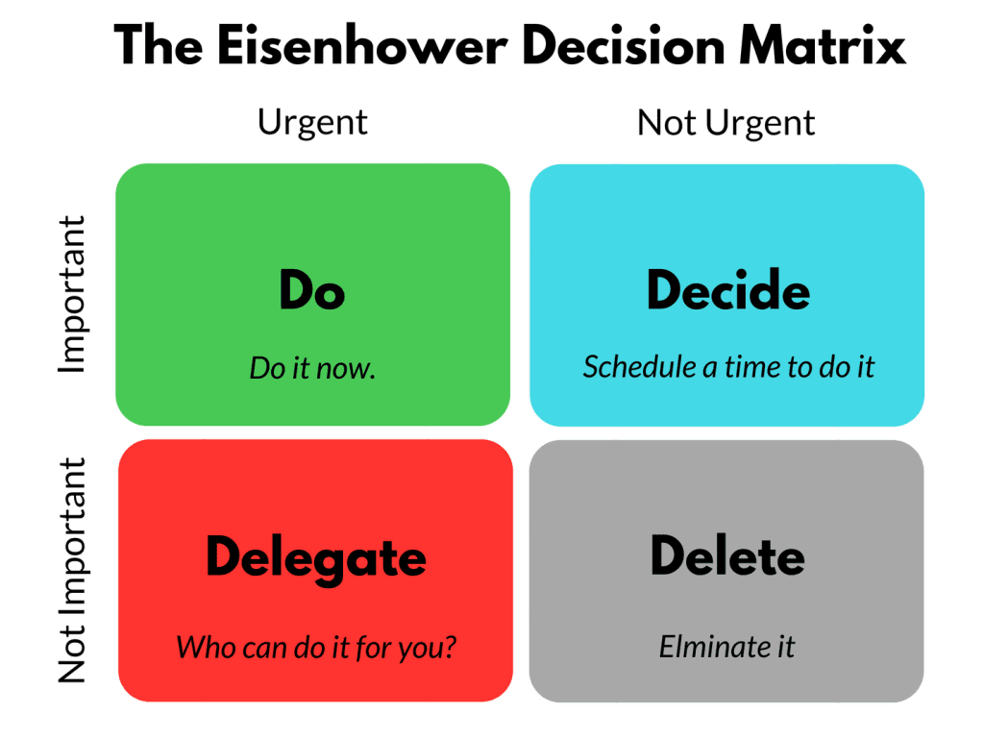

Slide 14
Eisenhower Matrix
Finishing a client project
Responding to some important emails
Strategic planning
Changing the ink in a printer
Purchasing a shirt for a meeting tomorrow
Spending time on social media
Playing video games
Conduct competitor analysis

Slide 15
Planning and Executing Tasks

Slide 16
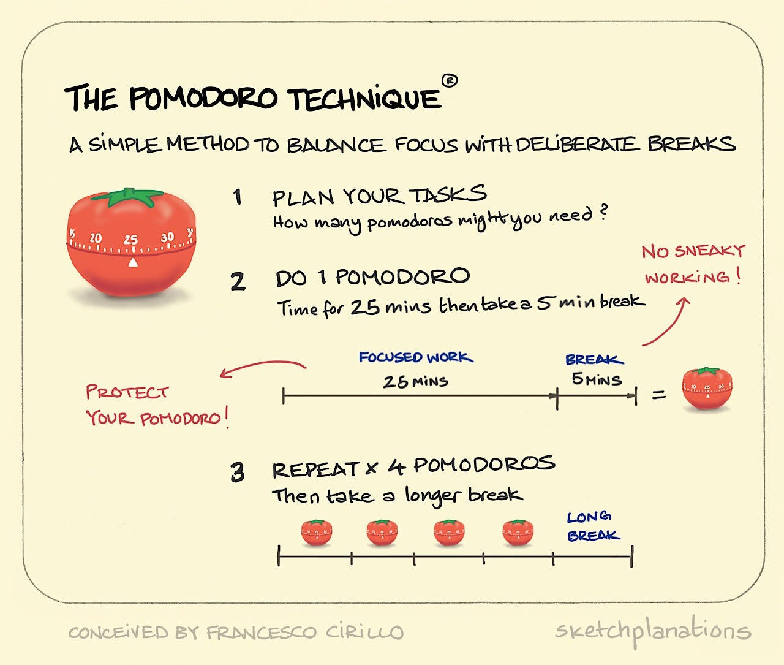

Slide 17
Thank You

